Slide 1

KI – Institute for Artificial Intelligence
Analytic Computing
Machine Learning
3 Bayesian Classification
Prof. Dr. Steffen Staab
Nadeen Fatallah Osama Mohamed
Daniel Frank Yi Wang Akram Sadat Hosseini Tim Schneider
Rodrigo Lopez
https://www.ki.uni-stuttgart.de/

Slide 2
Intermezzo: Discrete Probabilistic Reasoning

Slide 3
Inference
„Inferences are steps in reasoning, moving from premises to logical consequences...“
(https://en.wikipedia.org/w/index.php?title=Inference&oldid=953649900)
„Statistical inference uses mathematics to draw conclusions in the presence of uncertainty.“
(https://en.wikipedia.org/w/index.php?title=Inference&oldid=953649900)

Slide 4
Sources of uncertainty
Machine learning:
generalizes from (rather) small number of observations (i.e. samples)
to the general (including unseen objects)
Observations are uncertain, because
observations may be flawed (e.g. defect or inaccurate sensor)
reality may be uncertain
inherently uncertain (e.g. quantum dynamics)
incomplete knowledge best modelled by uncertainty (no Laplace‘s demon)
including: modeling with latent variables

Slide 5
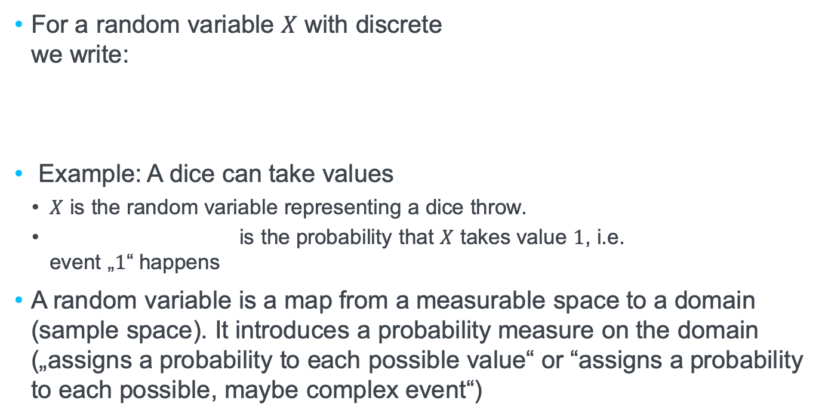
Probabilities and Random Variables
For a random variable $X$ with discrete we write:
Example: A dice can take values
$X$ is the random variable representing a dice throw.
is the probability that $X$ takes value $1$, i.e. event „$1$“ happens
A random variable is a map from a measurable space to a domain (sample space). It introduces a probability measure on the domain („assigns a probability to each possible value“ or “assigns a probability to each possible, maybe complex event“)

Slide 6
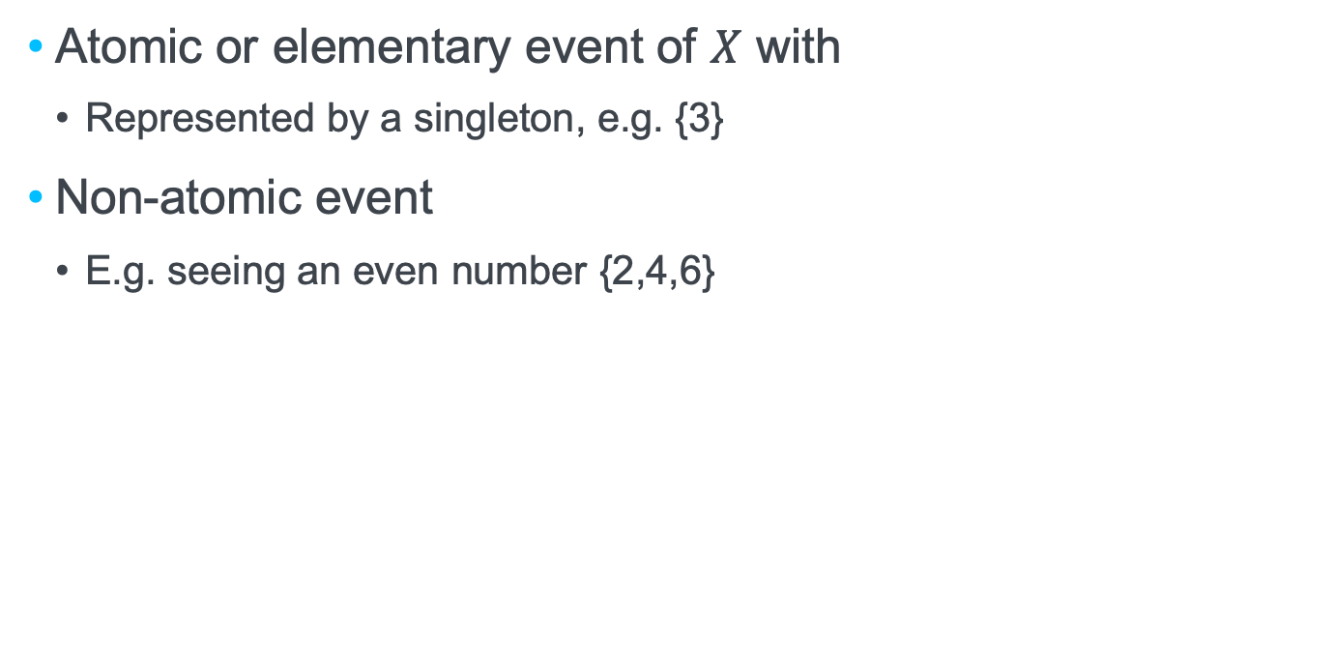
Atomic and non-atomic events
Atomic or elementary event of $X$ with
Represented by a singleton, e.g. {3}
Non-atomic event
E.g. seeing an even number {2,4,6}

Slide 7
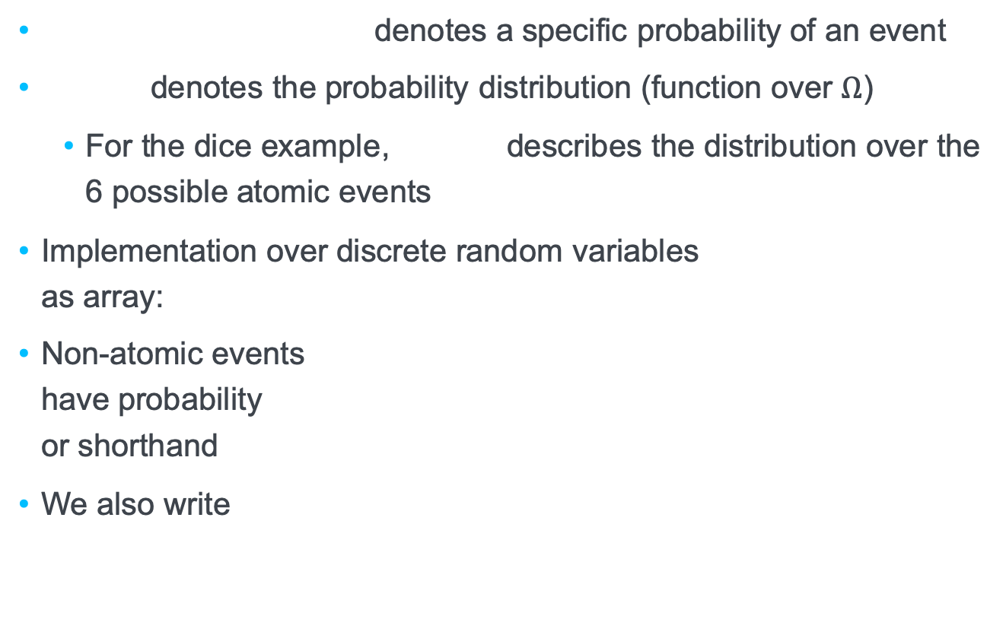
Notation
denotes a specific probability of an event
denotes the probability distribution (function over $Ω$)
For the dice example, describes the distribution over the 6 possible atomic events
Implementation over discrete random variables as array:
Non-atomic events have probability or shorthand
We also write

Slide 8
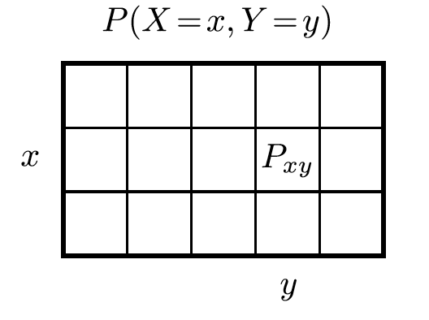
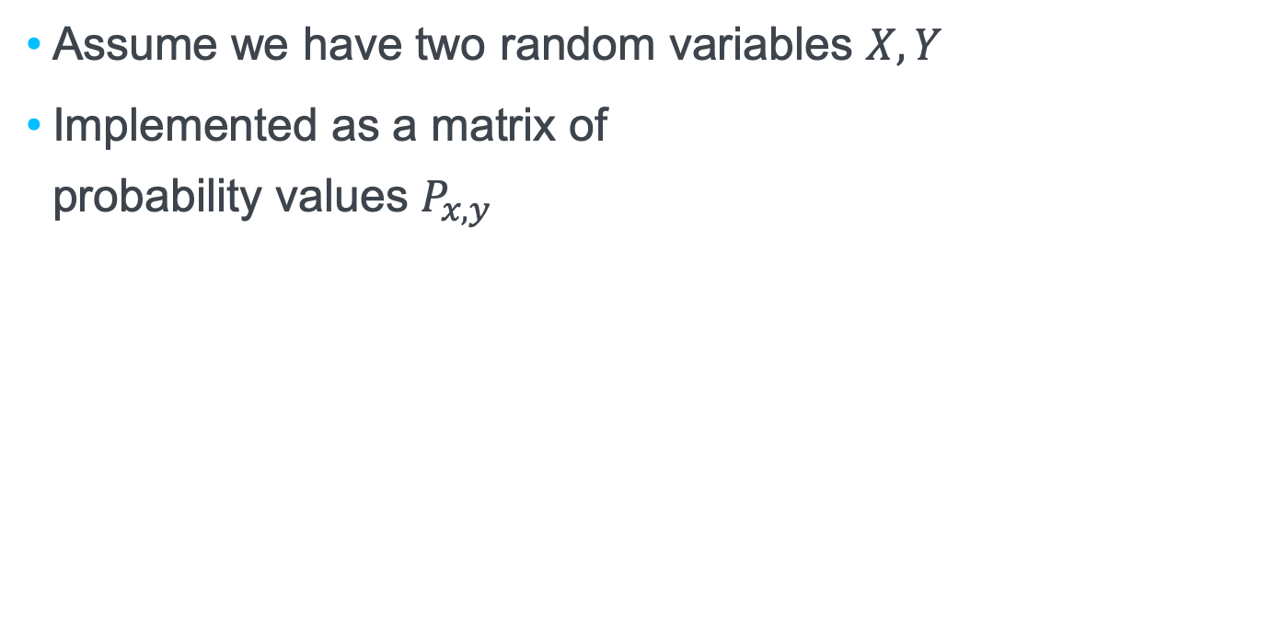
Joint distributions
Assume we have two random variables $X,Y$
Implemented as a matrix of probability values $P_{x,y}$

Slide 9
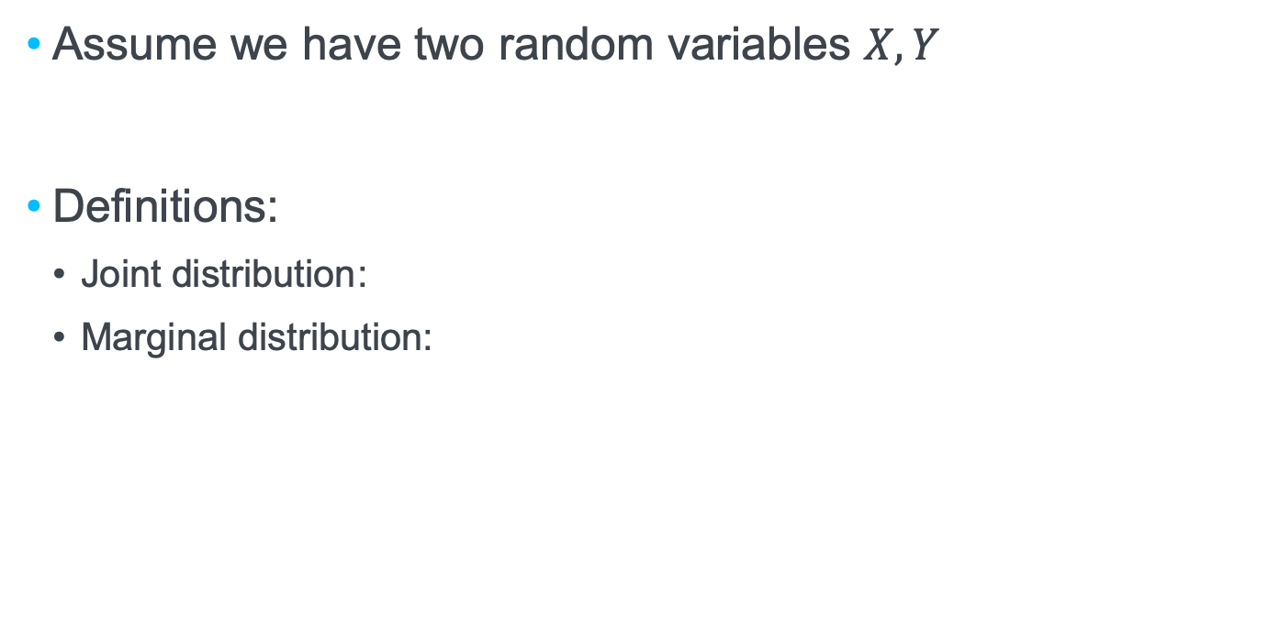
Joint distributions of two discrete random variable
Assume we have two random variables $X,Y$
Definitions:
Joint distribution:
Marginal distribution:

Slide 10
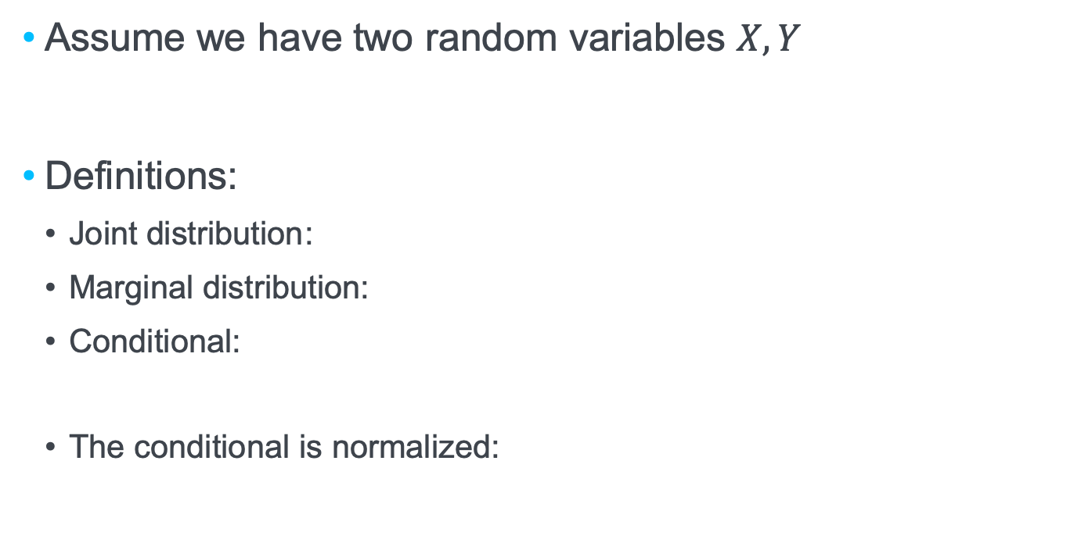
Joint distributions
Assume we have two random variables $X,Y$
Definitions:
Joint distribution:
Marginal distribution:
Conditional:
The conditional is normalized:

Slide 11
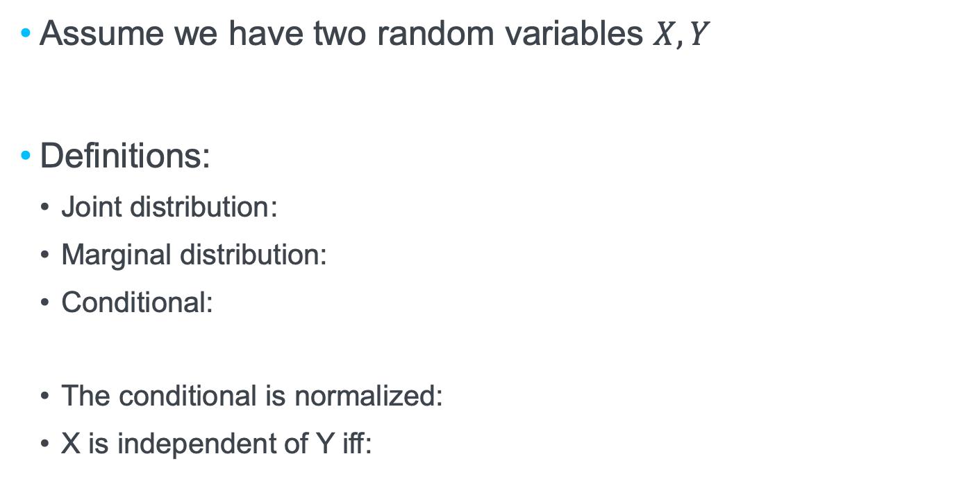
Joint distributions
Assume we have two random variables $X,Y$
Definitions:
Joint distribution:
Marginal distribution:
Conditional:
The conditional is normalized:
X is independent of Y iff:
identical colors stand for identical values

Slide 12
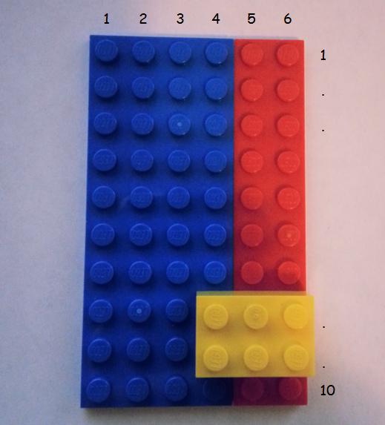
Visualizing specific conditional events
P (yellow | red) = 4/20 = 1/5
?
?
P (red| yellow) = 4/6 = 2/3
Can we infer something about P (red| yellow) if we know P (yellow | red) ?

Slide 13
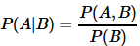
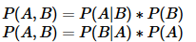
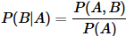
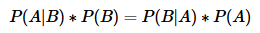
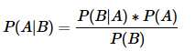
Reason for Bayes’ Theorem

Slide 14
Can I infer something about the second, by knowing about the first?
P (yellow | red) = 4/20 = 1/5
P (red| yellow) = 4/6 = 2/3
This is practically useful if the term on the left side is hard to measure, but the terms on the right side are easy to measure.

Slide 15
Bayes‘ Theorem
Talking about distributions
talking about probabilities of (often non-atomic) events

Slide 16
Probability theory for dealing with uncertainty
Frequentist probabilities are defined in the limit of an infinite number of trials
Example: “The probability of a particular coin landing heads up is 0.43”
Bayesian (subjective) probabilities quantify degrees of belief
Example: “The probability of rain tomorrow is 0.3” – not possible to repeat “tomorrow”

Slide 17
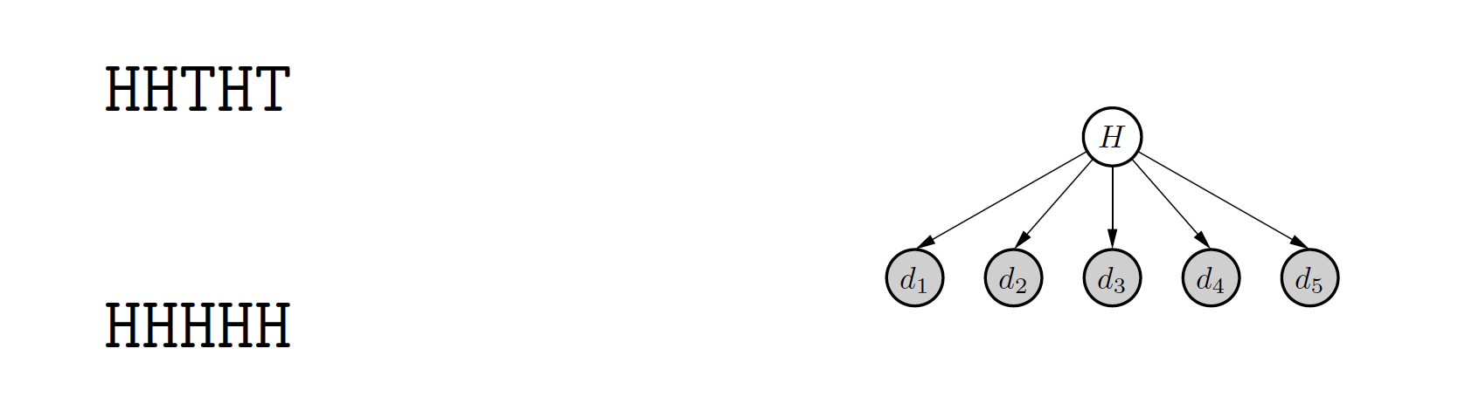
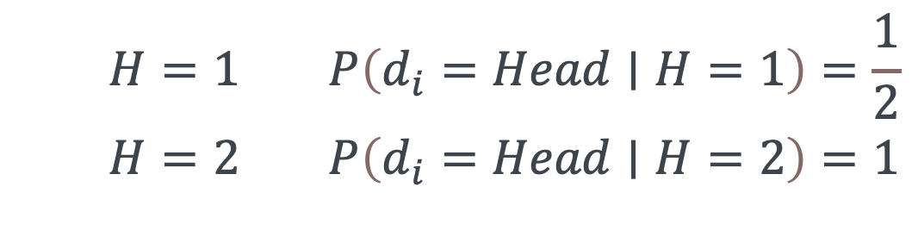
Fair or manipulated?
Coin flipping: What process produces these sequences?
Two hypotheses H=1, H=2
Fair coin:
Manipulated:
$$\begin{matrix} & H=1 P\left(d_{i}=Head∣H=1\right)=\frac{1}{2} \\ & H=2 P\left(d_{i}=Head∣H=2\right)=1 \\ & \end{matrix}$$

Slide 18
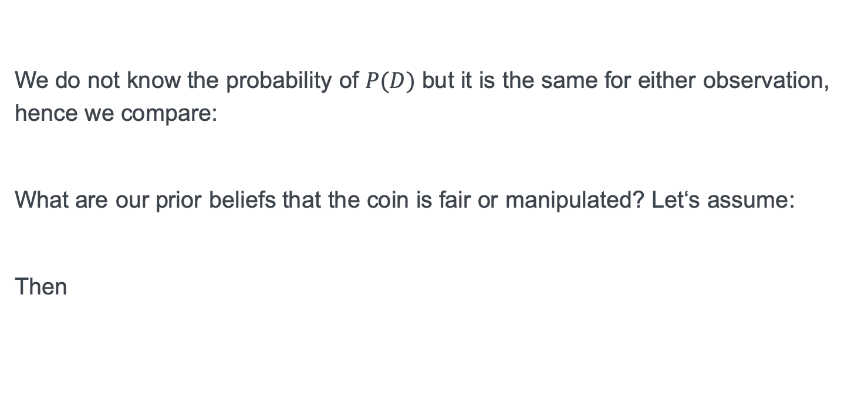
D=HHTHT
H1 fair, H2 manipulated
We do not know the probability of $P(D)$ but it is the same for either observation, hence we compare:
What are our prior beliefs that the coin is fair or manipulated? Let‘s assume:
Then
Notes:
\noindent$P(D|H=1)=\left(\frac{1}{2}\right)^5\hspace*{3cm} P(H=1 | D)=\frac{P(D|H=1)\cdot P(H=1)}{P(D)}\\[2ex]
P(D|H=2)=0\hspace*{3.5cm} P(H=2 | D)=\frac{P(D|H=2)\cdot P(H=2)}{P(D)}\\[12ex]
\frac{P(H=1 | D)}{P(H=2 | D)}=\frac{P(D|H=1)\cdot P(H=1)}{P(D|H=2)\cdot P(H=2)}\\[8ex]
P(H=1)=0.999, P(H=2)=0.001\\[8ex]
\frac{P(H=1 | D)}{P(H=2 | D)}=\frac{\left(\frac{1}{2}\right)^5}{0}\cdot\frac{0.999}{0.001}=\infty
$

Slide 19
D=HHTHT
H1 fair, H2 manipulated
We do not know the probability of $P(D)$ but it is the same for either observation, hence we compare:
What are our prior beliefs that the coin is fair or manipulated? Let‘s assume:
Then
Notes:
\noindent$P(D|H=1)=\left(\frac{1}{2}\right)^5\hspace*{3cm} P(H=1 | D)=\frac{P(D|H=1)\cdot P(H=1)}{P(D)}\\[2ex]
P(D|H=2)=0\hspace*{3.5cm} P(H=2 | D)=\frac{P(D|H=2)\cdot P(H=2)}{P(D)}\\[12ex]
\frac{P(H=1 | D)}{P(H=2 | D)}=\frac{P(D|H=1)\cdot P(H=1)}{P(D|H=2)\cdot P(H=2)}\\[8ex]
P(H=1)=0.999, P(H=2)=0.001\\[8ex]
\frac{P(H=1 | D)}{P(H=2 | D)}=\frac{\left(\frac{1}{2}\right)^5}{0}\cdot\frac{0.999}{0.001}=\infty
$

Slide 20
D=HHHHH
H1 fair, H2 manipulated
We do not know the probability of $P(D)$ but it is the same for either observation, hence we compare:
What are our prior beliefs that the coin is fair or manipulated? Let‘s assume:
Then
Notes:
\noindent$P(D|H=1)=\left(\frac{1}{2}\right)^5\hspace*{3cm} P(H=1 | D)=\frac{P(D|H=1)\cdot P(H=1)}{P(D)}\\[2ex]
P(D|H=2)=1\hspace*{3.5cm} P(H=2 | D)=\frac{P(D|H=2)\cdot P(H=2)}{P(D)}\\[12ex]
\frac{P(H=1 | D)}{P(H=2 | D)}=\frac{P(D|H=1)\cdot P(H=1)}{P(D|H=2)\cdot P(H=2)}\\[8ex]
P(H=1)=0.999, P(H=2)=0.001\\[8ex]
\frac{P(H=1 | D)}{P(H=2 | D)}=\frac{\left(\frac{1}{2}\right)^5}{1}\cdot\frac{0.999}{0.001}\approx 30
$

Slide 21
D=HHHHH
H1 fair, H2 manipulated
We do not know the probability of $P(D)$ but it is the same for either observation, hence we compare:
What are our prior beliefs that the coin is fair or manipulated? Let‘s assume:
Then
Notes:
\noindent$P(D|H=1)=\left(\frac{1}{2}\right)^5\hspace*{3cm} P(H=1 | D)=\frac{P(D|H=1)\cdot P(H=1)}{P(D)}\\[2ex]
P(D|H=2)=1\hspace*{3.5cm} P(H=2 | D)=\frac{P(D|H=2)\cdot P(H=2)}{P(D)}\\[12ex]
\frac{P(H=1 | D)}{P(H=2 | D)}=\frac{P(D|H=1)\cdot P(H=1)}{P(D|H=2)\cdot P(H=2)}\\[8ex]
P(H=1)=0.999, P(H=2)=0.001\\[8ex]
\frac{P(H=1 | D)}{P(H=2 | D)}=\frac{\left(\frac{1}{2}\right)^5}{1}\cdot\frac{0.999}{0.001}\approx 30
$

Slide 22
D=HHHHHHHHHH
H1 fair, H2 manipulated
We do not know the probability of $P(D)$ but it is the same for either observation, hence we compare:
What are our prior beliefs that the coin is fair or manipulated? Let‘s assume:
Then
Notes:
\noindent$P(D|H=1)=\left(\frac{1}{2}\right)^10\hspace*{3cm} P(H=1 | D)=\frac{P(D|H=1)\cdot P(H=1)}{P(D)}\\[2ex]
P(D|H=2)=1\hspace*{3.5cm} P(H=2 | D)=\frac{P(D|H=2)\cdot P(H=2)}{P(D)}\\[12ex]
\frac{P(H=1 | D)}{P(H=2 | D)}=\frac{P(D|H=1)\cdot P(H=1)}{P(D|H=2)\cdot P(H=2)}\\[8ex]
P(H=1)=0.999, P(H=2)=0.001\\[8ex]
\frac{P(H=1 | D)}{P(H=2 | D)}=\frac{(\frac{1}{1024}}{1}\cdot\frac{0.999}{0.001}\approx 30
$

Slide 23
https://xkcd.com/1132/

Slide 24
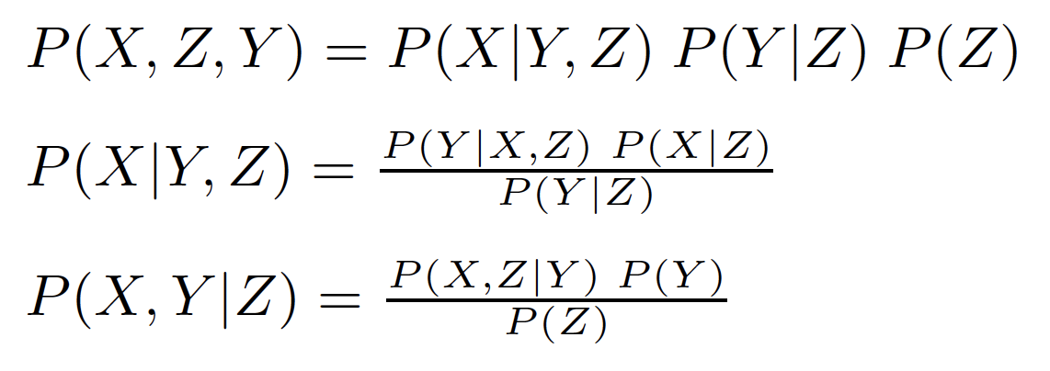
Joint Distributions for Three Random Variables
https://www.programming-idioms.org/idiom/27/create-a-3-dimensional-array/452/rust
Product rule and Bayes‘ theorem:
Notes:
\noindent $3$ random variables $X,Y,Z$, stored as rank 3 tensor\\
Joint distribution: $P(X,Y,Z)$\\
Marginal distribution: $P(X)=\Sigma_{Y,Z}P(X,Y,Z)$\\
Conditional distribution: $P(X|Y,Z)=\frac{P(X,Y,Z)}{P(Y,Z)}$\\
$X$ is conditionally independent of $Y$ given $Z$ iff: $P(X|Y,Z) = P(X|Z)$\\

Slide 25
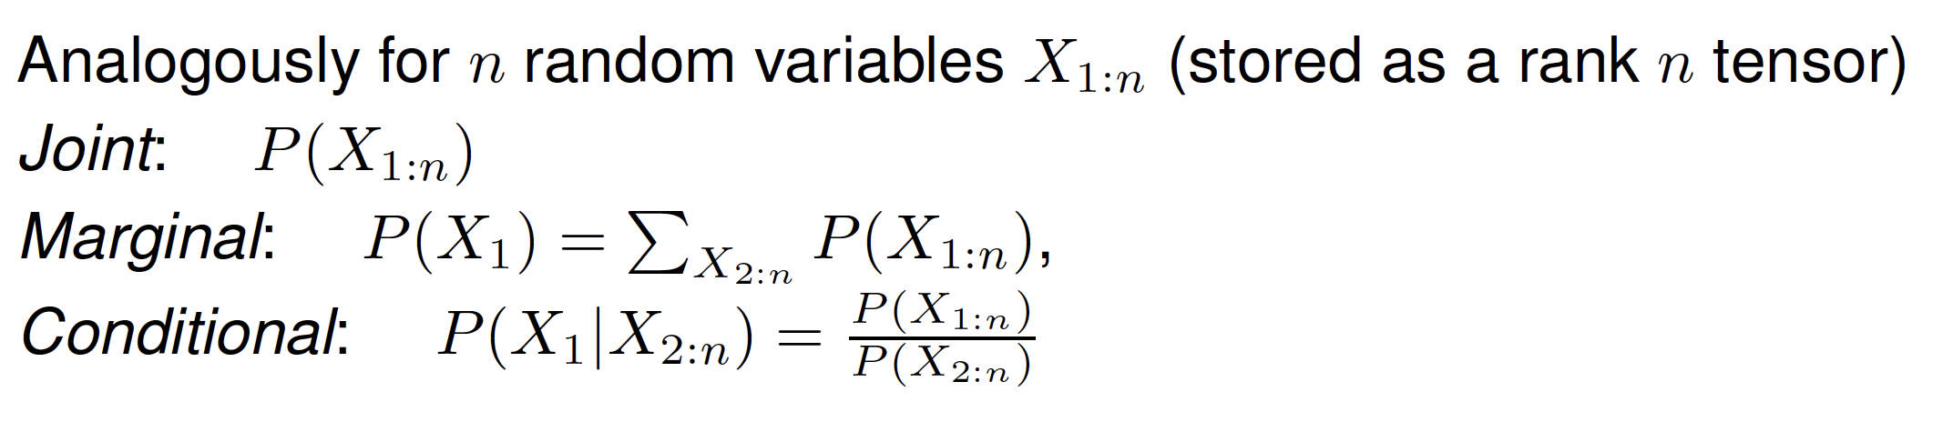
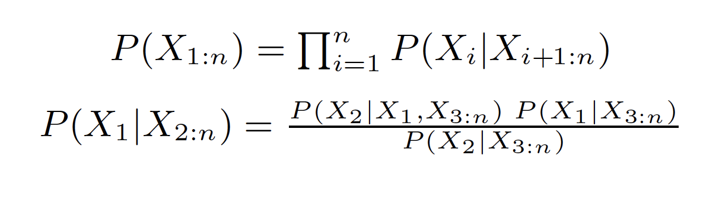
$n$ Random Variables
https://www.programming-idioms.org/idiom/27/create-a-3-dimensional-array/452/rust
Mapping joint atomic events to probabilities.
Storing probabilities in an n-dimensional array (tensor)
p[...,...,..., ,...]
Product rule and Bayes‘ theorem:
n entries
Notes:
\noindent $3$ random variables $X,Y,Z$, stored as rank 3 tensor\\
Joint distribution: $P(X,Y,Z)$\\
Marginal distribution: $P(X)=\Sigma_{Y,Z}P(X,Y,Z)$\\
Conditional distribution: $P(X|Y,Z)=\frac{P(X,Y,Z)}{P(Y,Z)}$\\
$X$ is conditionally independent of $Y$ given $Z$ iff: $P(X|Y,Z) = P(X|Z)$\\

Slide 26
Naïve Bayes

Slide 27
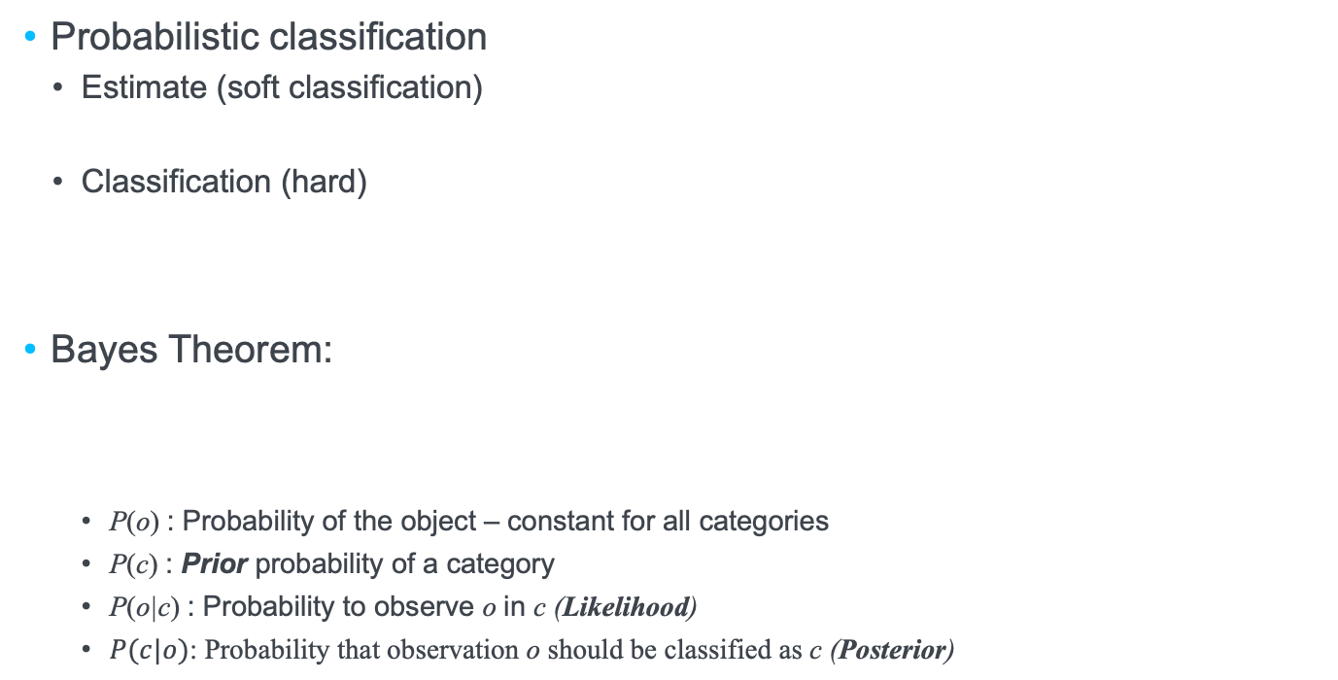
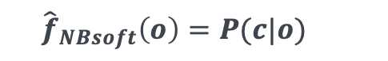
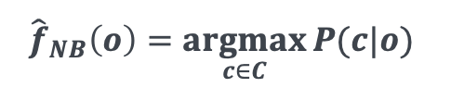
Bayes’ Classifier
Probabilistic classification
Estimate (soft classification)
Classification (hard)
Bayes Theorem:
P(o) : Probability of the object – constant for all categories
P(c) : Prior probability of a category
P(o|c) : Probability to observe o in c (Likelihood)
$P(c|o)$: Probability that observation o should be classified as c (Posterior)
$${\hat{f}}_{NBsoft}\left(o\right)=P(c|o){}$$
$${\hat{f}}_{NB}\left(o\right)=\underset{c∈C}{argmax}{P(c|o)}$$
Estimate from training data

Slide 28
Non-naïve Bayes
A₁
A₆
C
A₅
A₂
A₄
A₃
Attributes and class label are (interdependent) random variables
Notes:
\noindent $P(c|o)=P(c|x_1, x_2,\ldots,x_m)=\\[2ex]
\frac{P(c,x_1, x_2,\ldots,x_m)}{P(x_1, x_2,\ldots,x_m)}=\\[2ex]
\frac{P(c,x_1, x_2,\ldots,x_m)}{P(x_1, x_2,\ldots,x_{m-1}|x_m)\cdot P(x_m)}=\\[2ex]
\frac{P(c,x_1, x_2,\ldots,x_m)}{P(x_1, x_2,\ldots,x_{m-2}|x_{m-1},x_m)\cdot P(x_{m-1}|x_m) \cdot P(x_m)}=\\[2ex]
\ldots\\[2ex]
$

Slide 29
Resolving the Probabilities with all Dependencies
Non-naive!!!
From objects to attributes
impossible to measure,
getting worse and worse with increasing number of attributes
Notes:
\noindent $P(c|x_1,\ldots,x_m)=\frac{P(x_1,\ldots,x_m|c)\cdot P(c)}{P(x_1,\ldots,x_m)}=\\[2ex]
=\frac{P(x_1,\ldots,x_{m-1}|x_m,c)\cdot P(x_m|c)\cdot P(c)}{P(x_1,\ldots,x_m)}=\\[2ex]
=\frac{P(x_1,\ldots,x_{m-2}|x_{m-1},x_m,c)\cdot P(x_{m-1}|x_m,c)\cdot P(x_m|c)\cdot P(c)}{P(x_1,\ldots,x_m)}=\\[2ex]
=\frac{P(x_1,\ldots,x_{m-3}|x_{m-2},x_{m-1},x_m,c)\cdot P(x_{m-2}|x_{m-1},x_m,c)}{}\cdot\\[1ex]
\cdot\frac{P(x_{m-1}|x_m,c)\cdot P(x_m|c)\cdot P(c)}{P(x_1,\ldots,x_m)}=\ldots\\[2ex]
$

Slide 30
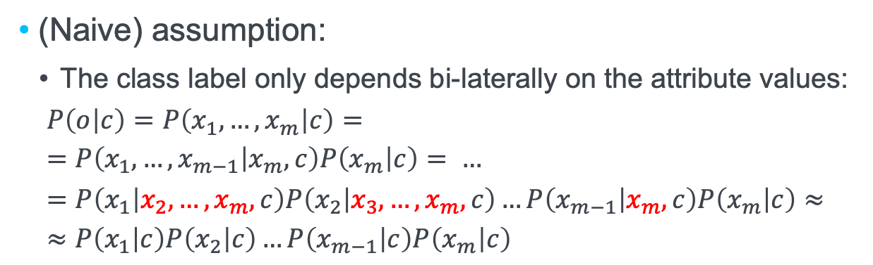
Naïve Bayes Assumption
A₁
A₆
A₁
A₆
C
A₅
C
A₅
A₂
A₂
A₄
A₄
A₃
A₃
(Naive) assumption:
The class label only depends bi-laterally on the attribute values:
$$P\left(o | c\right)=P\left(x_{1},…,x_{m} | c\right)= \\ =P\left(x_{1},…,x_{m−1} | x_{m},c\right)P\left(x_{m} | c\right)= …=P\left(x_{1} | x_{2},…,x_{m},c\right)P\left(x_{2} | x_{3},…,x_{m}, c\right)…P\left(x_{m−1} | x_{m}, c\right)P\left(x_{m} | c\right)≈ \\ ≈P\left(x_{1} | c\right)P\left(x_{2} | c\right)…P\left(x_{m−1} | c\right)P\left(x_{m} | c\right)$$

Slide 31

Simplifying Probabilities with Naïve Bayes Assumption
From objects to attributes,
from non-naive to naive Bayes
$$≈$$
To be estimated from training data: which fraction in a class has a certain attribute value?

Slide 32
Example of Naive Bayes
Color | Age | Class
Red | Old | Good
White | Old | Good
White | Young | Good
Red | Old | Bad
White | Young | bad
Wine
To classify: A new instance wine(red, young) Calculate value of the decision rule for both classes:
Class „good“:
P (good|red, young) = P (good) ⋅ P(red|good) ⋅ P(young|good) = 3/5 ⋅ 1/3 ⋅ 1/3 = 1/15
Class „bad“:
P (bad|red, young) = P (bad) ⋅ P(red| bad) ⋅ P(young| bad) = 2/5 ⋅ 1/2 ⋅ 1/2 = 1/10
Higher probability for class „bad“
Naive Bayes classifies new instance as „bad“

Slide 33
Estimating probabilities
In general:
Use count information, i.e. frequencies
Category priors:
Example: Mushrooms
„If you find a mushroom and do not know anything about it, there is a 21% chance it is poisonous“

Slide 34
Estimating probabilities
Feature |  | Edible | Poisonous
cap-shape | bell=b convex=x flat=f sunken=s | 29 34 13 3 | 0 20 1 0
cap-surface | fibrous=f scaly=y smooth=s | 14 36 29 | 0 13 8
cap-color | brown=n gray=g white=w yellow=y | 12 7 19 41 | 9 0 12 0
bruises | bruises=t no=f | 66 13 | 21 0
gill-spacing | close=c crowded=w | 65 14 | 21 0
gill-size | broad=b narrow=n | 64 15 | 0 21
gill-color | black=k brown=n gray=g pink=p white=w | 20 22 10 10 17 | 8 6 0 3 4
habitat | grasses=g meadows=m paths=p urban=u woods=d | 28 28 8 7 8 | 8 0 0 13 0
Categorial features:
Use count frequencies:
Example:
Zero Probabilities!

Slide 35
Smoothing for Naive Bayes
Laplace smoothing
Where V_{j} is the set of values for attribute x_{j}
Generalized additive smoothing (Lidstone):
with Parameter λ
One entry zero: overall product zero !!!

Slide 36
Estimating probabilities using smoothing
Example
Feature |  | Edible | Poisonous
cap-shape | bell=b convex=x flat=f sunken=s | 29 +1 34 +1 13 +1 3 +1 | 0 +1 20 +1 1 +1 0 +1
cap-surface | fibrous=f scaly=y smooth=s | 14 +1 36 +1 29 +1 | 0 +1 13 +1 8 +1
cap-color | brown=n gray=g white=w yellow=y | 12 +1 7 +1 19 +1 41 +1 | 9 +1 0 +1 12 +1 0 +1
bruises | bruises=t no=f | 66 +1 13 +1 | 21 +1 0 +1
gill-spacing | close=c crowded=w | 65 +1 14 +1 | 21 +1 0 +1
gill-size | broad=b narrow=n | 64 +1 15 +1 | 0 +1 21 +1
gill-color | black=k brown=n gray=g pink=p white=w | 20 +1 22 +1 10 +1 10 +1 17 +1 | 8 +1 6 +1 0 +1 3 +1 4 +1
habitat | grasses=g meadows=m paths=p urban=u woods=d | 28 +1 28 +1 8 +1 7 +1 8 +1 | 8 +1 0 +1 0 +1 13 +1 0 +1
Example:

Slide 37
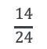
Example: Classification
Example
Feature |  | Edible | Poisonous
cap-shape | bell=b convex=x flat=f sunken=s | 29 +1 34 +1 13 +1 3 +1 | 0 +1 20 +1 1 +1 0 +1
cap-surface | fibrous=f scaly=y smooth=s | 14 +1 36 +1 29 +1 | 0 +1 13 +1 8 +1
cap-color | brown=n gray=g white=w yellow=y | 12 +1 7 +1 19 +1 41 +1 | 9 +1 0 +1 12 +1 0 +1
bruises | bruises=t no=f | 66 +1 13 +1 | 21 +1 0 +1
gill-spacing | close=c crowded=w | 65 +1 14 +1 | 21 +1 0 +1
gill-size | broad=b narrow=n | 64 +1 15 +1 | 0 +1 21 +1
gill-color | black=k brown=n gray=g pink=p white=w | 20 +1 22 +1 10 +1 10 +1 17 +1 | 8 +1 6 +1 0 +1 3 +1 4 +1
habitat | grasses=g meadows=m paths=p urban=u woods=d | 28 +1 28 +1 8 +1 7 +1 8 +1 | 8 +1 0 +1 0 +1 13 +1 0 +1
Mushroom: o = (f,y,w,t,c,n,p,g)
Category: poisonous:
$$\frac{14}{24}$$
P(poisonous|o) = 0.000247

Slide 38
Example: Classification
Example
Feature |  | Edible | Poisonous
cap-shape | bell=b convex=x flat=f sunken=s | 29 +1 34 +1 13 +1 3 +1 | 0 +1 20 +1 1 +1 0 +1
cap-surface | fibrous=f scaly=y smooth=s | 14 +1 36 +1 29 +1 | 0 +1 13 +1 8 +1
cap-color | brown=n gray=g white=w yellow=y | 12 +1 7 +1 19 +1 41 +1 | 9 +1 0 +1 12 +1 0 +1
bruises | bruises=t no=f | 66 +1 13 +1 | 21 +1 0 +1
gill-spacing | close=c crowded=w | 65 +1 14 +1 | 21 +1 0 +1
gill-size | broad=b narrow=n | 64 +1 15 +1 | 0 +1 21 +1
gill-color | black=k brown=n gray=g pink=p white=w | 20 +1 22 +1 10 +1 10 +1 17 +1 | 8 +1 6 +1 0 +1 3 +1 4 +1
habitat | grasses=g meadows=m paths=p urban=u woods=d | 28 +1 28 +1 8 +1 7 +1 8 +1 | 8 +1 0 +1 0 +1 13 +1 0 +1
Mushroom: o = (f,y,w,t,c,n,p,g)
Category: edible:
Poisonous!
P(edible|o) = 0.000087

Slide 39
Implementation Detail
High number of attributes and attribute values:
Many multiplications
Very small values
Use logarithm:
Risk of issues with accurate representation

Slide 40
Naive Bayes for Text Classification

Slide 41
Why is Text Different?
Text as set of terms
Bag of words model
Attributes
Terms (words)
Presence (binary)
Frequency (tf)
Vocabulary:
Hundreds of thousands of attributes
In one document: typically only a small fraction used
data
web
huge
is
the

Slide 42
Multinomial Naive Bayes
Terms which are not present do not affect the class association
Involve term frequencies to estimate P(d|c)
Reformulation:
Comparable to unigram Language Models

Slide 43
Estimating Probabilities
MLE
Category prior P(c_{i}) as before
Term probabilities in category:
Smoothing
Laplace smoothing

Slide 44
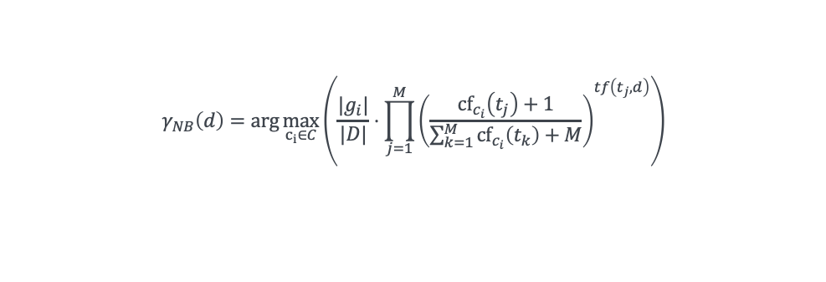
Classification Function
Multinomial NB classifier:
g_{i} : ground truth documents for c_{i}
D : set of training documents
M : size of vocabulary
cf_{ci}(t_{j}) : collection frequency of t_{j} restricted on c_{i}
tf(t_{j},d) : term frequency of t_{j} in d
For practical reasons:
Treat all documents from one category as one large document
Sum over logs
$$γ_{NB}\left(d\right)=\arg{\max_{c_{i}∈C}\left(\frac{|g_{i}|}{|D|}⋅{\prod_{j=1}^{M}{\left(\frac{{cf}_{c_{i}}\left(t_{j}\right)+1}{\sum_{k=1}^{M}{{cf}_{c_{i}}\left(t_{k}\right)+M}}\right)}}^{tf\left(t_{j},d\right)}\right)}$$

Slide 45
Example
Example
30 training documents
3 categories: economics, politics, tourism
Category priors:
Term | d₁ | d₂ | d₃ | d₄ | d₅ | d₆ | d₇ | d₈ | d₉ | d₁₀ | d₁₁ | d₁₂ | d₁₃ | d₁₄ | _{d15} | d₁₆ | d₁₇ | d₁₈ | d₁₉ | d₂₀ | d₂₁ | d₂₂ | d₂₃ | d₂₄ | d₂₅ | d₂₆ | d₂₇ | d₂₈ | d₂₉ | d₃₀ | Σ
agency | 2 |  |  |  | 1 |  |  | 1 |  |  |  |  |  |  |  |  |  |  |  |  |  |  |  | 3 | 2 |  |  | 6 |  |  | 15
airplane |  |  |  |  |  | 1 |  |  |  |  | 2 |  |  |  |  |  |  |  |  |  |  | 2 | 1 |  | 1 | 3 | 1 |  | 4 |  | 15
beach |  |  |  |  |  |  |  |  |  |  |  |  |  |  |  |  |  |  |  |  | 8 | 1 |  | 2 |  |  | 4 |  |  | 5 | 20
boat |  |  |  |  |  |  |  |  |  | 2 |  |  |  |  |  |  |  |  |  |  | 3 |  | 1 |  |  |  |  |  | 1 |  | 7
city |  | 3 |  |  |  | 1 |  |  |  |  |  | 2 |  |  | 2 |  |  |  |  |  |  | 1 |  |  | 1 |  | 3 |  |  | 1 | 14
company | 4 | 2 | 2 |  | 1 |  | 2 |  | 1 | 3 |  |  | 1 |  | 1 |  |  | 2 |  |  |  | 1 |  |  |  |  |  |  |  |  | 20
government |  |  |  | 2 |  |  |  |  |  |  |  | 3 |  | 1 | 2 | 2 | 5 |  | 2 |  |  |  |  |  |  |  |  |  |  |  | 17
island |  |  |  |  | 1 |  |  |  |  |  |  |  |  |  |  |  |  |  |  | 1 | 2 |  | 2 |  | 1 |  |  |  | 3 |  | 10
journey |  |  |  |  |  |  |  |  |  |  |  |  |  |  |  | 1 |  |  | 1 |  |  | 3 | 1 | 2 |  |  | 1 | 5 |  | 7 | 21
law |  |  |  | 3 |  |  |  | 1 |  |  |  | 7 | 4 | 3 | 2 |  | 5 |  |  |  |  |  |  |  |  |  | 3 |  |  |  | 28
president |  | 1 |  |  |  |  |  | 1 |  |  | 2 |  | 4 | 1 | 2 |  | 2 | 5 |  |  |  |  |  |  |  | 1 |  |  |  |  | 19
tax |  |  | 1 | 5 |  | 2 |  | 3 |  |  | 2 |  | 1 |  |  | 3 |  | 5 |  | 1 |  |  |  |  |  |  |  |  |  |  | 23
turnover | 1 |  | 4 | 3 | 2 |  |  | 1 | 1 | 7 |  |  |  |  |  | 1 |  |  |  |  |  |  |  |  |  |  |  |  | 1 |  | 21
Category | E | E | E | E | E | E | E | E | E | E | P | P | P | P | P | P | P | P | P | P | T | T | T | T | T | T | T | T | T | T

Slide 46
Example
Example
Term | E | P | T
agency | 4 |  | 11
airplane | 1 | 2 | 12
beach |  |  | 20
boat | 2 |  | 5
city | 4 | 4 | 6
company | 15 | 4 | 1
government | 2 | 15
island | 1 | 1 | 8
journey |  | 2 | 19
law | 4 | 21 | 3
president | 2 | 16 | 1
tax | 11 | 12
turnover | 19 | 1 | 1
Total | 65 | 78 | 87
Aggregate term frequencies in categories
Determine category length
Sum of term frequencies
Estimate term probabilities
Include smoothing

Slide 47
Example
Example
Term | E | P | T
agency | 0.06 | 0.01 | 0.12
airplane | 0.03 | 0.03 | 0.13
beach | 0.01 | 0.01 | 0.21
boat | 0.04 | 0.01 | 0.06
city | 0.06 | 0.05 | 0.07
company | 0.21 | 0.05 | 0.02
government | 0.04 | 0.18 | 0.01
island | 0.03 | 0.02 | 0.09
journey | 0.01 | 0.03 | 0.20
law | 0.06 | 0.24 | 0.04
president | 0.04 | 0.18 | 0.01
tax | 0.15 | 0.14 | 0.01
turnover | 0.26 | 0.02 | 0.02
Total | 1.00 | 1.00 | 1.00
Aggregate term frequencies in categories
Determine category length
Sum of term frequencies
Estimate term probabilities
Include smoothing
For all categories and terms

Slide 48
Example
Example
Term | E | P | T
agency | 0.06 | 0.01 | 0.12
airplane | 0.03 | 0.03 | 0.13
beach | 0.01 | 0.01 | 0.21
boat | 0.04 | 0.01 | 0.06
city | 0.06 | 0.05 | 0.07
company | 0.21 | 0.05 | 0.02
government | 0.04 | 0.18 | 0.01
island | 0.03 | 0.02 | 0.09
journey | 0.01 | 0.03 | 0.20
law | 0.06 | 0.24 | 0.04
president | 0.04 | 0.18 | 0.01
tax | 0.15 | 0.14 | 0.01
turnover | 0.26 | 0.02 | 0.02
Total | 1.00 | 1.00 | 1.00
New documents (now with tf)
agency (1), island (2), journey (2), beach (4)
Second document
company (1), law (2), government (5), tax (3)

Slide 49
Intermezzo: Continuous Probabilistic Reasoning

Slide 50
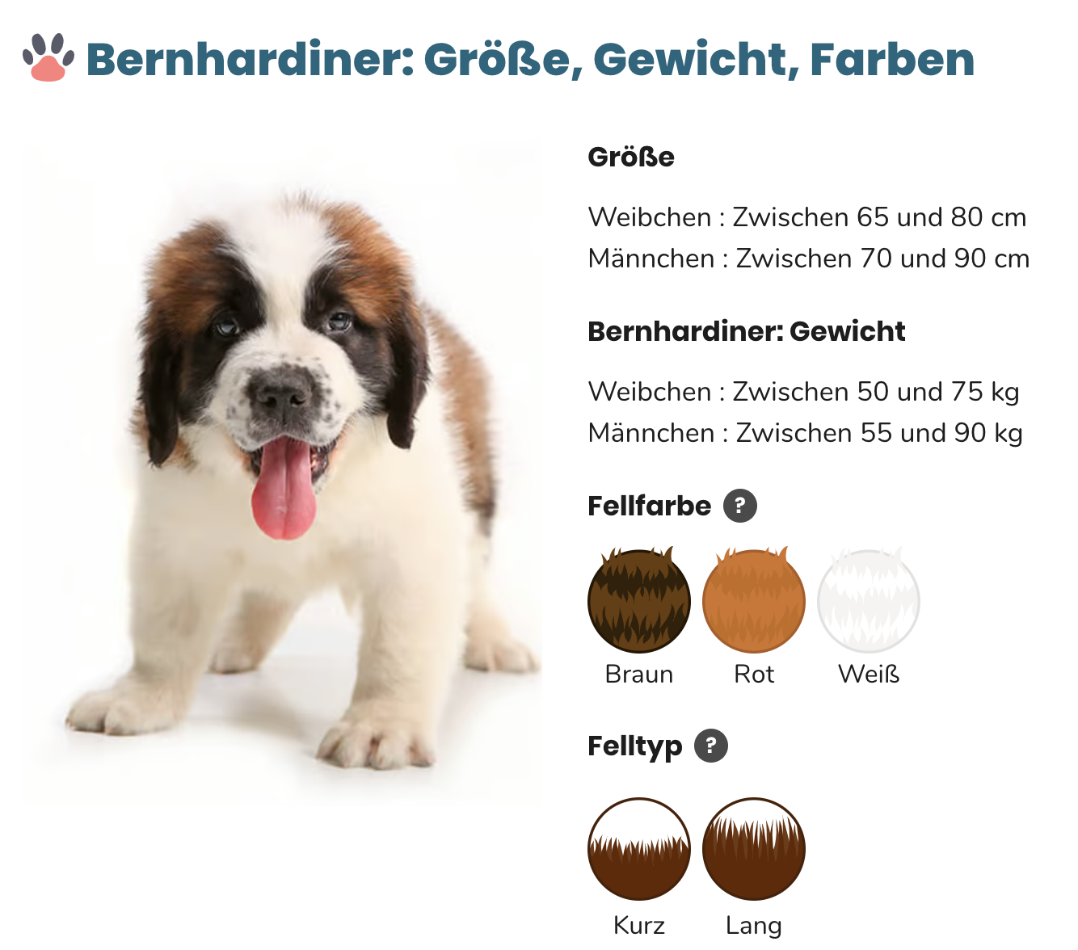
Numeric values
Gender | weight | height
F | 52,33 | 66,40
F | 64,39 | 73,64
F | 51,07 | 65,64
F | 66,27 | 74,76
F | 69,68 | 76,81
F | 51,03 | 65,62
F | 63,48 | 73,09
M | 79,17 | 83,81
M | 62,40 | 74,23
M | 62,94 | 74,54
M | 67,22 | 76,98
M | 59,27 | 72,44
M | 59,04 | 72,31
M | 62,81 | 74,46
M | 56,14 | 70,65
M | 78,44 | 83,40
M | 74,27 | 81,01
M | 69,61 | 78,35
Single observations are too specific
P(Height = 83 cm) ?
P(Height = 83.81 cm) ?

Slide 51
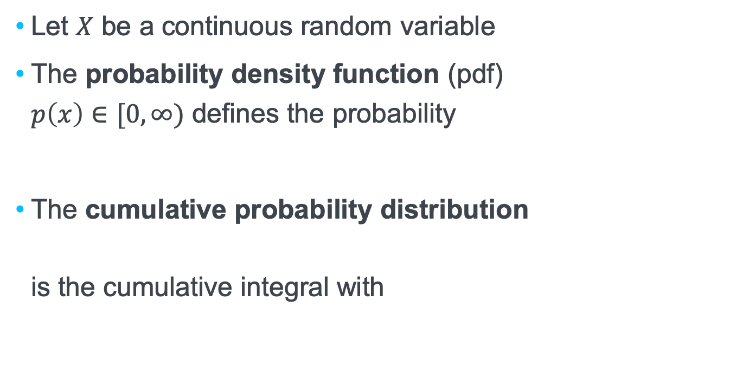
Distributions over continuous domains
Let $X$ be a continuous random variable
The probability density function (pdf) $p\left(x\right)∈[0,∞)$ defines the probability
The cumulative probability distribution is the cumulative integral with
Notes:
$P(a\leq x\leq b)=\int_a^bp(x)dx\in [0,1]$
$F(y)=P(x\leq y)=\int_{-\infty}^y p(x)dx\in [0,1] $
$\lim_{y\rightarrow \infty}F(y)=1$

Slide 52
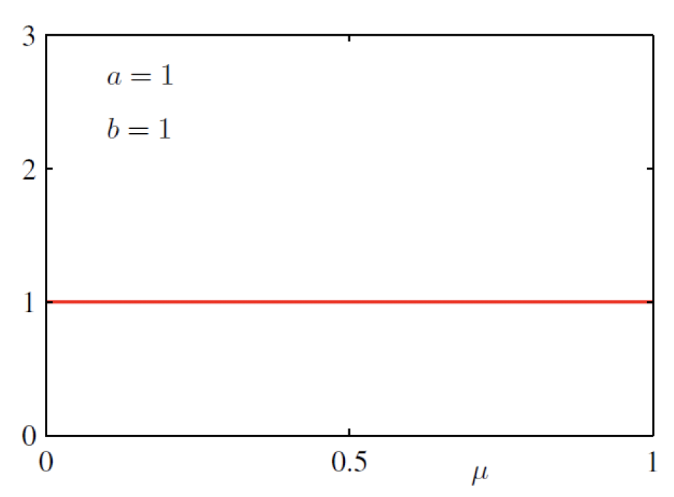
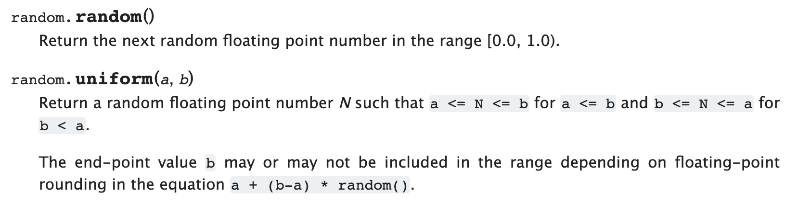
Uniform continuous distribution over $[0,1]$
e.g. Python

Slide 53
Numeric values
Gender | weight | height
F | 52,33 | 66,40
F | 64,39 | 73,64
F | 51,07 | 65,64
F | 66,27 | 74,76
F | 69,68 | 76,81
F | 51,03 | 65,62
F | 63,48 | 73,09
M | 79,17 | 83,81
M | 62,40 | 74,23
M | 62,94 | 74,54
M | 67,22 | 76,98
M | 59,27 | 72,44
M | 59,04 | 72,31
M | 62,81 | 74,46
M | 56,14 | 70,65
M | 78,44 | 83,40
M | 74,27 | 81,01
M | 69,61 | 78,35
Single observations are too specific
P(Height = 83 cm) ?
P(Height = 83.81 cm) ?

Slide 54
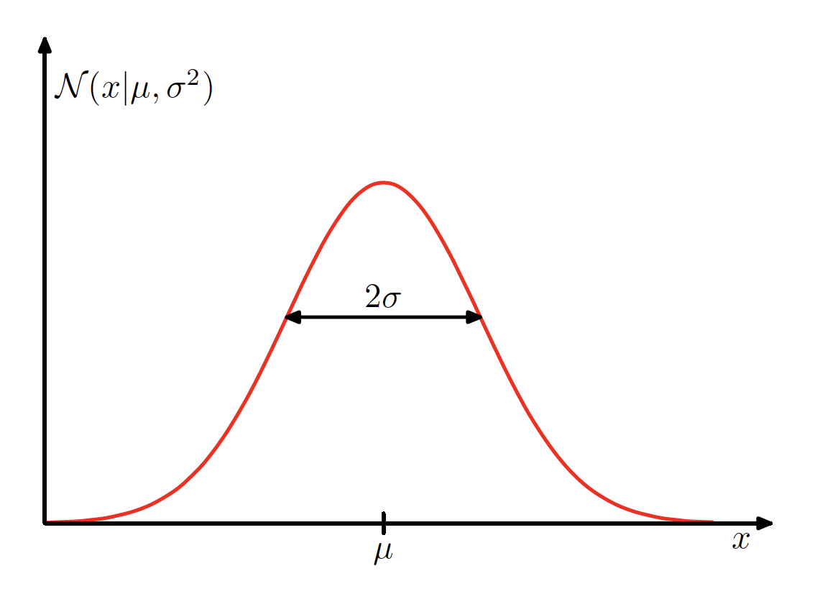
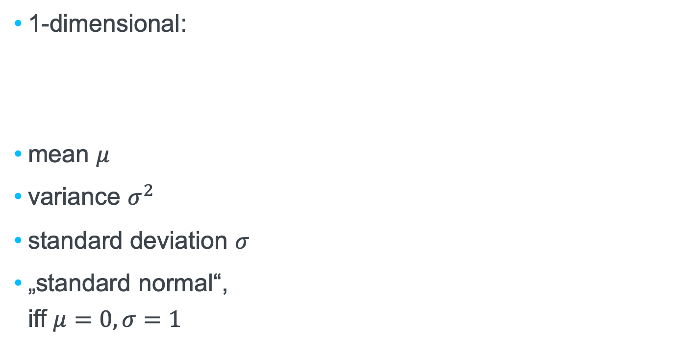
1-dim Gaussian distribution (also „Normal distribution“)
1-dimensional:
mean $μ$
variance $σ^{2}$
standard deviation $σ$
„standard normal“, iff $μ=0,σ=1$
Notes:
$\mathcal{N}(x|\mu,\sigma^2)=p(x|\mu,\sigma^2)=\frac{1}{\sigma\sqrt{2\pi}}e^{-\frac{1}{2}\left(\frac{x-\mu}{\sigma}\right)^2}$

Slide 55
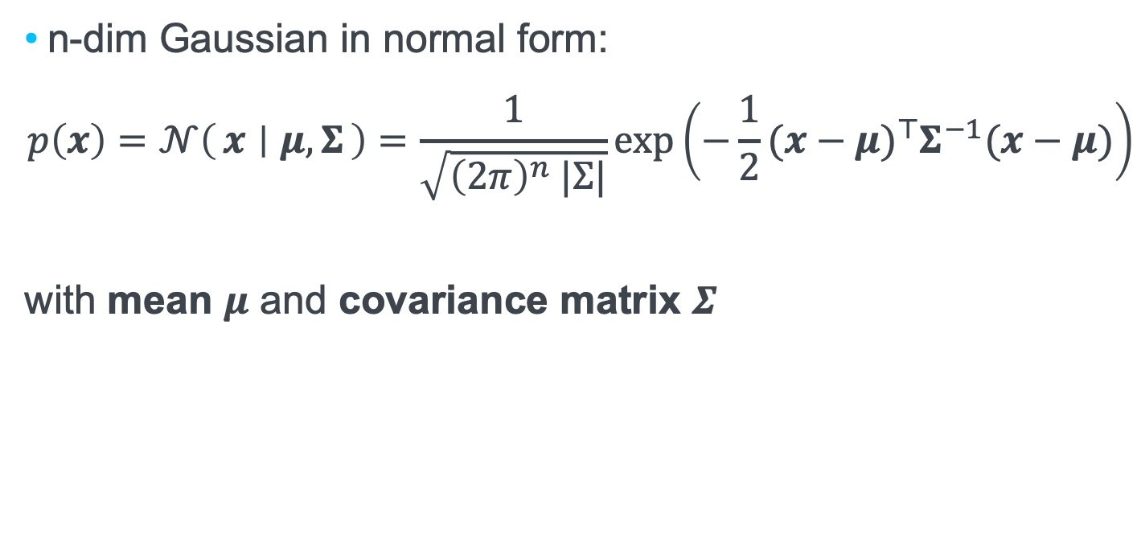
n-dim Gaussian distribution (also „Normal distribution“)
n-dim Gaussian in normal form:
$$p\left(x\right)=𝒩\left(x ∣ μ,Σ\right)=\frac{1}{\sqrt{{\left(2π\right)}^{n} |Σ|}}exp\left(−\frac{1}{2}(x−μ)^{⊤}Σ^{−1}(x−μ)\right)$$
with mean $μ$ and covariance matrix $Σ$
Notes:
$\mathcal{N}(x|\mu,\Sigma)=\frac{1}{\sqrt{2\pi\Sigma}}e^{-\frac{1}{2}\left( {x-\mu}\right)^T{\Sigma}\left({x-\mu}\right)}$

Slide 56
Numeric Values

Slide 57
Numeric values
Gender | weight | height
F | 52,33 | 66,40
F | 64,39 | 73,64
F | 51,07 | 65,64
F | 66,27 | 74,76
F | 69,68 | 76,81
F | 51,03 | 65,62
F | 63,48 | 73,09
M | 79,17 | 83,81
M | 62,40 | 74,23
M | 62,94 | 74,54
M | 67,22 | 76,98
M | 59,27 | 72,44
M | 59,04 | 72,31
M | 62,81 | 74,46
M | 56,14 | 70,65
M | 78,44 | 83,40
M | 74,27 | 81,01
M | 69,61 | 78,35
Single observations are too specific
P(Height = 83 cm) ?
P(Height = 83.81 cm) ?
Assumption:
Attribute values follow a normal distribution (in each class).
Maximum-likelihood estimate of parameters:

Slide 58
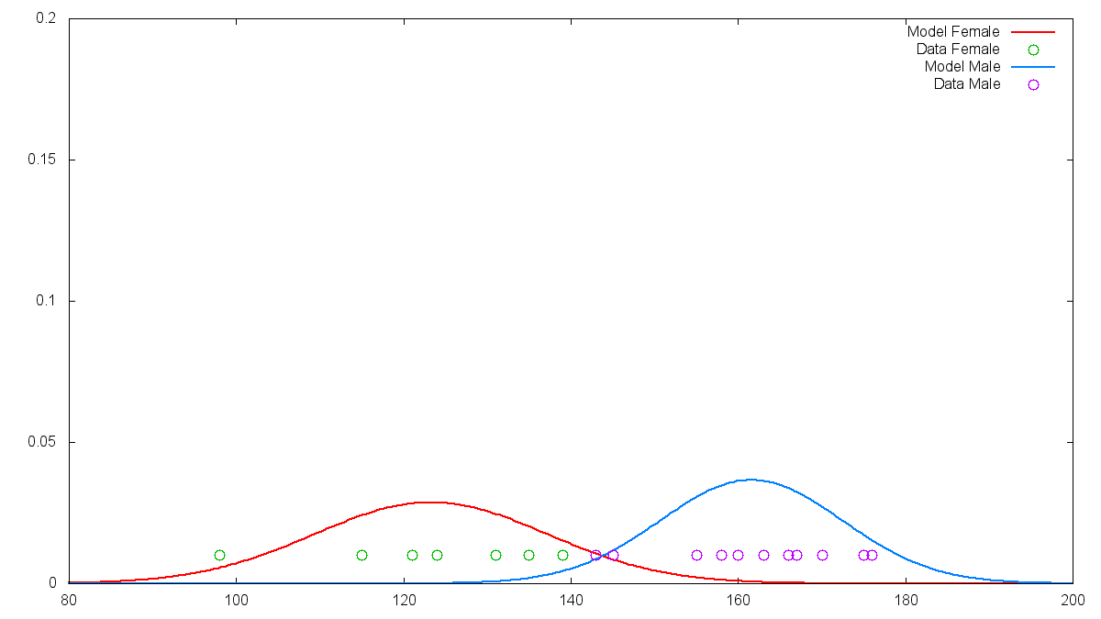
Modelling Distribution for Numeric Data
Learning the parameters for height

Slide 59
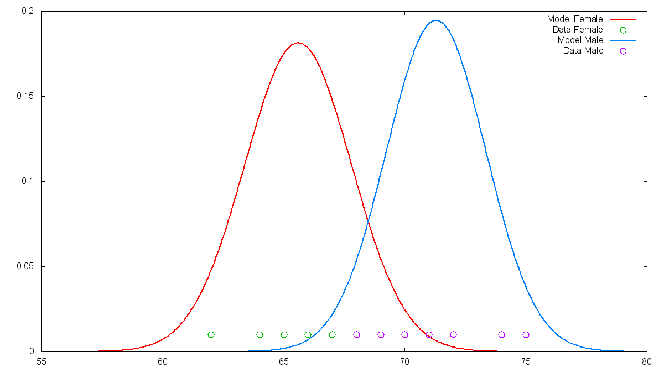
Modelling Distribution for Numeric Data
Learning the parameters for weight

Slide 60
Making Use of the Distributions
Still:
P(weight = 67 | c = f ) = 0
Solution:
Assume a weight „around“ the actual value.
P(weight = 67 ± ε | c = f )
Implementation:
Use value of density function

Slide 61
Example
Gender | weight | height
F | 66 | 124
F | 66 | 115
F | 64 | 121
F | 69 | 139
F | 62 | 98
F | 67 | 135
F | 65 | 131
M | 74 | 170
M | 68 | 166
M | 70 | 155
M | 72 | 167
M | 71 | 158
M | 72 | 175
M | 69 | 143
M | 72 | 163
M | 75 | 160
M | 70 | 145
M | 71 | 176
New data point:
Weight: 67, Height: 155
Parameters
Weight:
μ_{wF} = 65.57 σ _{wF} = 2.22
μ_{wM} = 71.57 σ _{wM} = 2.02
Height:
μ_{hF} = 123.29 σ _{hF} = 13.89
μ_{hM} = 161.64 σ _{hM} = 10.90
Priors:
Do the priors make sense?

Slide 62
Example
Class „Female“:
P(height = 155 | c = f ) = 0.0021
P(weight = 67 | c = f ) = 0.1459
With prior:
P(f | o) = 0.00012
Without prior:
P(f | o) = 0.00031
Class „Male“:
P(height = 155 | c = m ) = 0.0304
P(weight = 67 | c = m ) = 0.0223
With prior:
P(m | o) = 0.00041
Without prior:
P(m | o) = 0.00068

Slide 63
Conclusion: `Graphical Models´
You have now seen the first, specific `graphical model´: probabilistic reasoning with Naive Bayes
`graphical models‘ are probabilistic models with multiple random variables and dependencies
`graphical models´ are a general framework for modelling problems:
regression and classification, decision making
unsupervised learning
reinforcement learning
language modeling
Probabilistic Machine Learning –
Lecture in winter terms

Slide 64
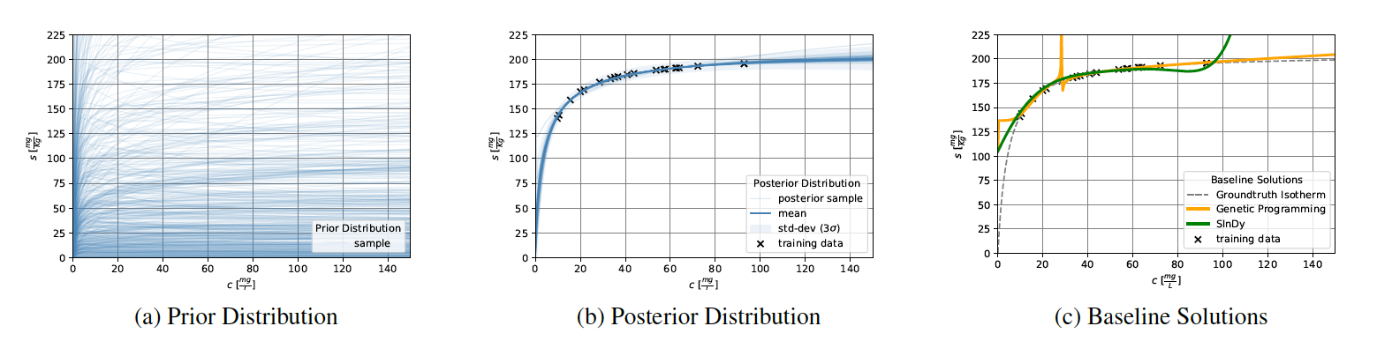
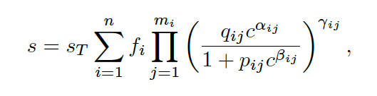
Current research at Analytic Computing: Predicting functions with Bayesian methods
Diagrams by Tim Schneider

Slide 65

IPVS
Steffen Staab
Steffen.staab@ipvs.uni-stuttgart.de
To be defined
ipvs.uni-stuttgart.de/departments/ac/
Analytic Computing, IPVS
Universitätsstraße 32, 50569 Stuttgart

